Slide 1
Vision Transformers
Lecture 8
Part 7
Generative AI for Computer Vision

Slide 2
Content
Vision Transformer
DEtection TRansformer (DETR)
SWIN Transformer

Slide 3
Vision Transformers
Vision Transformers (ViTs) are a type of Transformer architecture designed specifically for computer vision tasks.
Unlike traditional CNNs, which process images using convolutional filters, a Vision Transformer divides an image into small, fixed-size patches and treats these patches as a sequence of tokens, similar to words in a sentence.
Each image patch is converted into an embedding, and positional embeddings are added to preserve information about the location of each patch.
These embeddings are then passed through Transformer encoder layers, where self-attention allows the model to learn relationships between different parts of the image.

Slide 4
Vision Transformers
For example, when recognizing a dog, the model can relate patches containing the dog's face, body, and legs even when they are far apart in the image.
The final representation can be used for tasks such as image classification, object detection, and image segmentation.
Vision Transformers have become an important alternative to CNNs because their self-attention mechanism enables them to capture global relationships within an image effectively.

Slide 5
Patch Embedding
Vision Transformer (ViT) is a Transformer-based architecture mainly used for image classification tasks.
ViT uses the encoder part of the Transformer architecture.
Instead of processing the entire image directly, ViT divides the image into several small, fixed-size patches.
Each patch is converted into a numerical representation called an embedding, and positional information is added to indicate the location of each patch.
Alexey Dosovitskiy et. al. AN IMAGE IS WORTH 16X16 WORDS: TRANSFORMERS FOR IMAGE RECOGNITION AT SCALE, ICLR 2021

Slide 6
Patch Embedding
These patch embeddings are then provided as a sequence of inputs to the Transformer encoder.
The self-attention mechanism allows the model to learn relationships between different patches and understand the overall context of the image.
Finally, the learned representation is used to classify the image into the appropriate category.
Alexey Dosovitskiy et. al. AN IMAGE IS WORTH 16X16 WORDS: TRANSFORMERS FOR IMAGE RECOGNITION AT SCALE, ICLR 2021

Slide 7
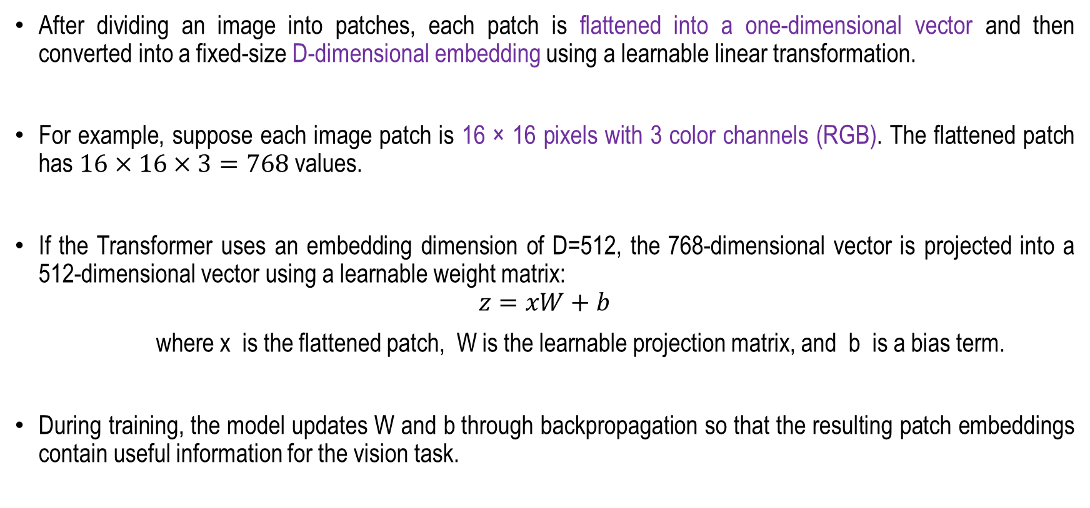
Patch Embedding
After dividing an image into patches, each patch is flattened into a one-dimensional vector and then converted into a fixed-size D-dimensional embedding using a learnable linear transformation.
For example, suppose each image patch is 16 × 16 pixels with 3 color channels (RGB). The flattened patch has $16×16×3=768$ values.
If the Transformer uses an embedding dimension of D=512, the 768-dimensional vector is projected into a 512-dimensional vector using a learnable weight matrix:
$$z=xW+b$$
where x is the flattened patch, W is the learnable projection matrix, and b is a bias term.
During training, the model updates W and b through backpropagation so that the resulting patch embeddings contain useful information for the vision task.
Alexey Dosovitskiy et. al. AN IMAGE IS WORTH 16X16 WORDS: TRANSFORMERS FOR IMAGE RECOGNITION AT SCALE, ICLR 2021

Slide 8
Patch Embedding
Concatenate the class embedding, which is used to learn the representative characteristics of the entire image.
And then add the position embedding that provides positional information.
Note that the class embedding and position embedding are also learnable.
Alexey Dosovitskiy et. al. AN IMAGE IS WORTH 16X16 WORDS: TRANSFORMERS FOR IMAGE RECOGNITION AT SCALE, ICLR 2021

Slide 9
Vision Transformer
Encoder Architecture
The Vision Transformer (ViT) is an encoder-only architecture that applies the Transformer encoder mechanism to image representation learning.
Unlike encoder–decoder Transformer models, ViT consists exclusively of a stack of Transformer encoder layers and does not employ a separate decoder network.
The encoder in a Vision Transformer (ViT) is responsible for learning contextual representations from image patches through a sequence of Transformer encoder layers.
Initially, an input image is divided into fixed-size, non-overlapping patches, which are flattened and projected into a latent embedding space.
Positional embeddings are added to these patch embeddings to preserve spatial information that is otherwise absent from the self-attention mechanism.
Alexey Dosovitskiy et. al. AN IMAGE IS WORTH 16X16 WORDS: TRANSFORMERS FOR IMAGE RECOGNITION AT SCALE, ICLR 2021

Slide 10
Vision Transformer
Encoder Architecture
Each encoder layer consists primarily of a Multi-Head Self-Attention (MHSA) module followed by a position-wise Multi-Layer Perceptron (MLP), with residual connections and Layer Normalization applied around these sublayers.
The self-attention mechanism computes query, key, and value representations to model relationships between all image patches, enabling the network to capture both local and long-range dependencies.
The MLP further transforms the attended features using nonlinear projections, increasing the representational capacity of the model.
By stacking multiple encoder layers, the Vision Transformer progressively learns hierarchical and globally contextualized visual representations, which can subsequently be used for image classification or other downstream computer vision tasks.
Alexey Dosovitskiy et. al. AN IMAGE IS WORTH 16X16 WORDS: TRANSFORMERS FOR IMAGE RECOGNITION AT SCALE, ICLR 2021

Slide 11
Vision Transformer
Encoder Architecture
Thus, as an encoder-only model, ViT transforms an input image into a contextualized feature representation without generating an output sequence, making it particularly suitable for image classification, feature extraction, and other vision tasks.
Alexey Dosovitskiy et. al. AN IMAGE IS WORTH 16X16 WORDS: TRANSFORMERS FOR IMAGE RECOGNITION AT SCALE, ICLR 2021

Slide 12
DEtection TRansformer (DETR)
The main ingredients of the new framework, called DEtection TRansformer or DETR, are a set-based global loss that forces unique predictions via bipartite matching, and a transformer encoder-decoder architecture.
Given a fixed small set of learned object queries, DETR reasons about the relations of the objects and the global image context to directly output the final set of predictions in parallel.
The new model is conceptually simple and does not require a specialized library, unlike many other modern detectors.
DETR demonstrates accuracy and run-time performance on par with the well-established and highly-optimized Faster RCNN baseline on the challenging COCO object detection dataset.
Moreover, DETR can be easily generalized to produce panoptic segmentation in a unified manner.
Nicolas Carion , Francisco Massa , Gabriel Synnaeve, Nicolas Usunier, Alexander Kirillov, and Sergey Zagoruyko, “End-to-End Object Detection with Transformer”, arXiv:2005.12872

Slide 13
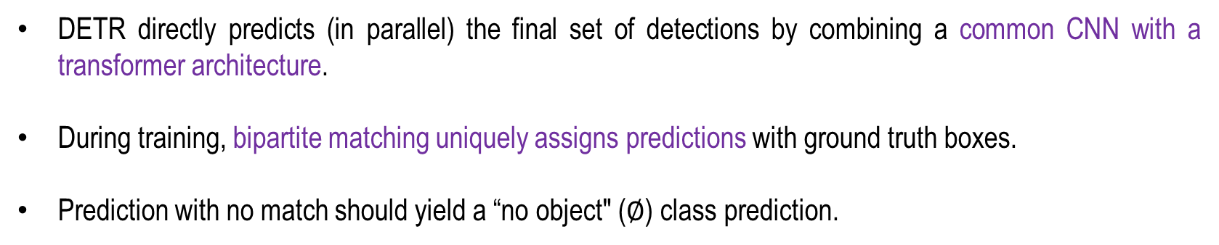
DEtection TRansformer (DETR)
DETR directly predicts (in parallel) the final set of detections by combining a common CNN with a transformer architecture.
During training, bipartite matching uniquely assigns predictions with ground truth boxes.
Prediction with no match should yield a “no object" ($∅$) class prediction.
Nicolas Carion , Francisco Massa , Gabriel Synnaeve, Nicolas Usunier, Alexander Kirillov, and Sergey Zagoruyko, “End-to-End Object Detection with Transformer”, arXiv:2005.12872

Slide 14
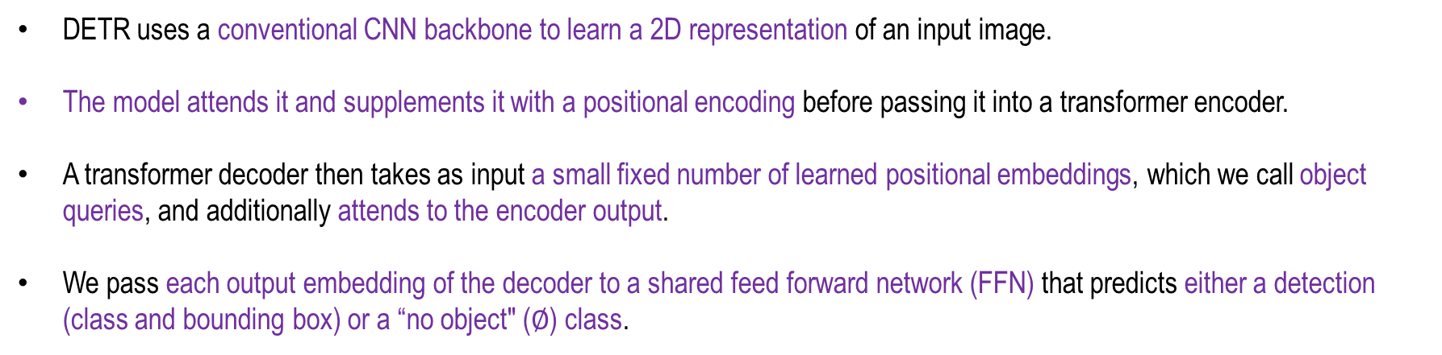
DETR Architecture
DETR uses a conventional CNN backbone to learn a 2D representation of an input image.
The model attends it and supplements it with a positional encoding before passing it into a transformer encoder.
A transformer decoder then takes as input a small fixed number of learned positional embeddings, which we call object queries, and additionally attends to the encoder output.
We pass each output embedding of the decoder to a shared feed forward network (FFN) that predicts either a detection (class and bounding box) or a “no object" ($∅$) class.
Nicolas Carion , Francisco Massa , Gabriel Synnaeve, Nicolas Usunier, Alexander Kirillov, and Sergey Zagoruyko, “End-to-End Object Detection with Transformer”, arXiv:2005.12872

Slide 15
DEtection TRansformer (DETR)
DETR (Detection Transformer) is a transformer-based object detection framework designed to perform end-to-end detection while eliminating the need for traditional components such as anchor boxes and region proposal networks.
Unlike conventional object detection methods that rely on multiple handcrafted stages for generating and refining candidate regions, DETR formulates object detection as a direct set-prediction problem.
It predicts a fixed set of object representations, including class labels and bounding-box coordinates, directly from the input image in a single, unified pipeline.
This end-to-end formulation simplifies the overall detection architecture and enables the model to capture relationships between objects and global image context more effectively.

Slide 16
DEtection TRansformer (DETR)
The core architecture of DETR consists of a convolutional backbone followed by a transformer encoder-decoder.
The backbone extracts visual features from the input image, which are subsequently processed by the transformer encoder to model long-range dependencies and global contextual relationships.
The decoder then uses a fixed set of learned object queries to generate individual object representations and predict their corresponding class labels and bounding-box coordinates.
By combining visual features with self-attention and cross-attention mechanisms, DETR can reason about the image globally and produce a set of object predictions without requiring manually designed detection components.

Slide 17
DEtection TRansformer (DETR)
A key contribution of DETR is its use of bipartite matching to address the permutation-invariant nature of object detection.
Since the predicted objects are not associated with predefined anchors or specific ground-truth positions, DETR employs a Hungarian matching algorithm to establish an optimal one-to-one correspondence between predicted objects and ground-truth objects.
The resulting matching forms the basis of the set-based loss used to jointly optimize classification and bounding-box regression.
Consequently, DETR provides a conceptually simpler and more unified approach to object detection, demonstrating how transformer architectures can replace several conventional detection mechanisms while maintaining competitive detection performance.

Slide 18
Swin Transformer
The Swin Transformer introduces a hierarchical vision Transformer architecture that addresses the computational limitations of conventional Vision Transformers by restricting self-attention to local, non-overlapping windows.
Instead of computing global self-attention across all image patches, Swin Transformer partitions the feature map into fixed-size windows and performs self-attention independently within each window, substantially reducing computational complexity.
To establish communication between neighboring windows, the architecture alternates between regular window-based multi-head self-attention (W-MSA) and shifted window-based multi-head self-attention (SW-MSA) in successive Transformer blocks.
This shifted-window mechanism enables efficient cross-window information exchange while preserving the computational benefits of localized attention.
Z. Liu et al., "Swin Transformer: Hierarchical Vision Transformer using Shifted Windows," in 2021 IEEE/CVF International Conference on Computer Vision (ICCV)

Slide 19
Swin Transformer
Furthermore, Swin Transformer adopts a hierarchical representation-learning strategy through progressive patch merging, which reduces spatial resolution while increasing feature dimensionality and consequently produces multi-scale feature representations.
As a result, its computational complexity grows linearly with the number of image pixels, making the architecture considerably more scalable than global-attention-based Transformers for high-resolution inputs.
These properties enable Swin Transformer to serve as a versatile backbone for a wide range of computer vision applications, including image classification, object detection, semantic segmentation, and other dense prediction tasks.

Slide 20
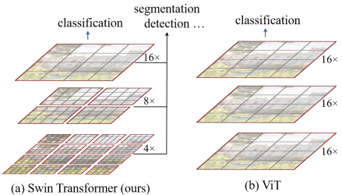
Swin Transformer
The Swin Transformer builds hierarchical feature maps by merging image patches (shown in gray) in deeper layers.
It has linear computation complexity to input image size due to computation of self-attention only within each local window (shown in red).
It can thus serve as a general-purpose backbone for both image classification and dense recognition tasks.
In contrast, previous vision Transformers produce feature maps of a single low resolution and having quadratic computation complexity to input image size due to computation of self attention globally.
Z. Liu et al., "Swin Transformer: Hierarchical Vision Transformer using Shifted Windows," in 2021 IEEE/CVF International Conference on Computer Vision (ICCV)

Slide 21
Swin Transformer
Furthermore, Swin Transformer adopts a hierarchical representation-learning strategy through progressive patch merging, which reduces spatial resolution while increasing feature dimensionality and consequently produces multi-scale feature representations.
As a result, its computational complexity grows linearly with the number of image pixels, making the architecture considerably more scalable than global-attention-based Transformers for high-resolution inputs.
These properties enable Swin Transformer to serve as a versatile backbone for a wide range of computer vision applications, including image classification, object detection, semantic segmentation, and other dense prediction tasks.

Slide 22
Variational Auto-Encoder
Next
Lecture 9: Part 1
Generative AI for Computer Vision

